Slide 1
PSEUDO CODE AND FLOWCHARTS
BY; MATLAB GROUP

Slide 2
THE NEWTON RAPHSON METHOD
The Newton-Raphson method is an iterative numerical technique used to find approximate roots of an equation:
f(x)=0
The general Newton-Raphson formula is:
x_{n+1}=x_{n}−f(x_{n})/f′(x_{n})
where:
x_{n}= current approximation
x_{n+1}= next approximation
f(x_{n}) = value of the function
f′(x_{n}) = derivative of the function

Slide 3
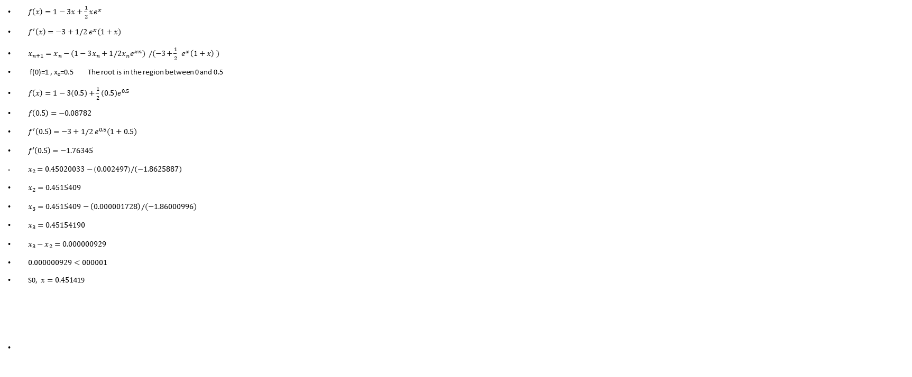
Use Newton Raphson method to solve f(x)=1-3x+1/2xe^{x}
$f\left(x\right)=1−3x+\frac{1}{2}xe^{x}$
$f^{′}\left(x\right)=−3+1/2{ e}^{x}(1+x)$
$x_{n+1}=x_{n}−(1−3x_{n}+1/2x_{n}e^{xn}) /(−3+\frac{1}{2}{ e}^{x}\left(1+x\right) )$
f(0)=1 , x₀=0.5 The root is in the region between 0 and 0.5
$f\left(x\right)=1−3(0.5)+\frac{1}{2}(0.5)e^{0.5}$
$f\left(0.5\right)=−0.08782$
$f^{′}\left(0.5\right)=−3+1/2{ e}^{0.5}(1+0.5)$
$f′\left(0.5\right)=−1.76345$
$x_{2}=0.45020033−\left(0.002497\right)/(−1.8625887)$
$x_{2}=0.4515409$
$x_{3}=0.4515409−\left(0.000001728\right)/(−1.86000996)$
$x_{3}=0.45154190$
$x_{3}−x_{2}=0.000000929$
$0.000000929<000001$
S0, $x=0.451$419

Slide 4
THE NRM PSEUDO CODE
START
↓
Define f(x) and f'(x)
↓
Set x₀ = 0.5 and tolerance = 10⁻⁶
↓
Calculate xnew
↓
Calculate error
↓
Is error < tolerance?
YES → Display root → STOP
NO → Set x = xnew → Repeat

Slide 5
Using The “for” loop
for i = 1:maxIter
fx = f(x);
dfx = df(x);
x_new = x - fx/dfx;
error = abs(x_new-x);
if error < tol
break
end
x = x_new;
end

Slide 6
using the ‘while’ loop
while error >= tol && i < maxIter
i = i + 1;
x_new = x - f(x)/df(x);
error = abs(x_new-x);
x = x_new;
end

Slide 7
NRM FLOW CHART

Slide 8
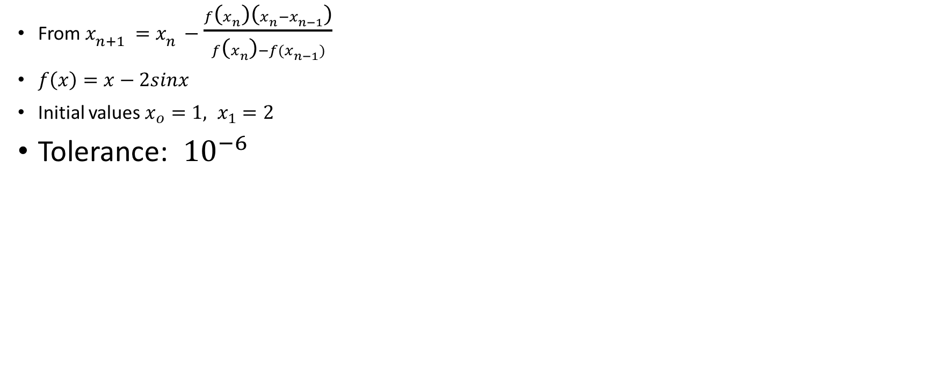
N0.2; SOLVE f(x)=x-2sinx=0 USING THE SECANT RULE
From $x_{n+1}=x_{n}−\frac{f\left(x_{n}\right)\left(x_{n}−x_{n−1}\right)}{f\left(x_{n}\right)−f(x_{n−1})}$
$f\left(x\right)=x−2sinx$
Initial values $x_{o}=1, x_{1}=2$
Tolerance: ${10}^{−6}$

Slide 9
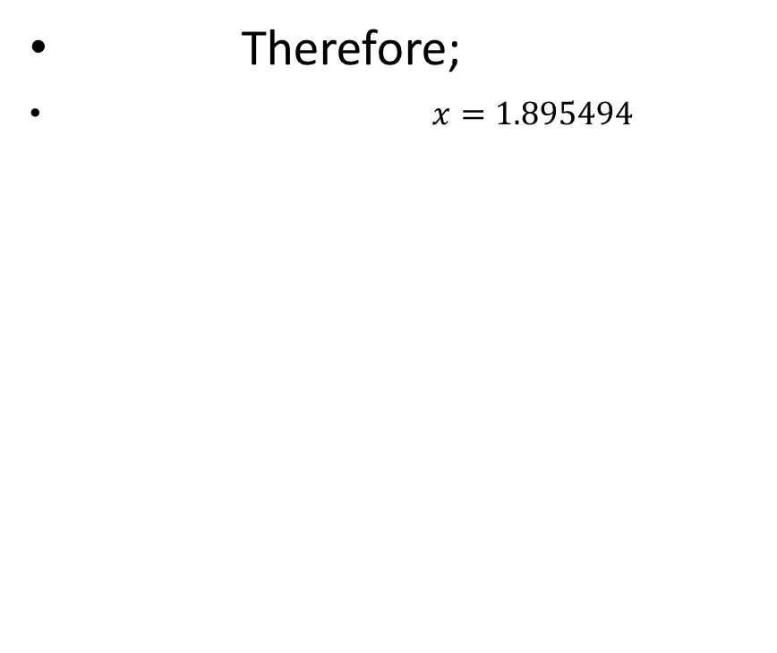
SECANT ITERATION AND RESULTS
Iteration | Xn−1 | Xn | Xn+1
0 | 1.000000 | 2.000000 | 1.790125
1 | 2.000000 | 1.790125 | 1.889121
2 | 1.790125 | 1.889121 | 1.895915
3 | 1.889121 | 1.895915 | 1.895493
4 | 1.895915 | 1.895493 | 1.895494
5 | 1.895493 | 1.895494 | 1.895494
Therefore;
$x=1.895494$

Slide 10
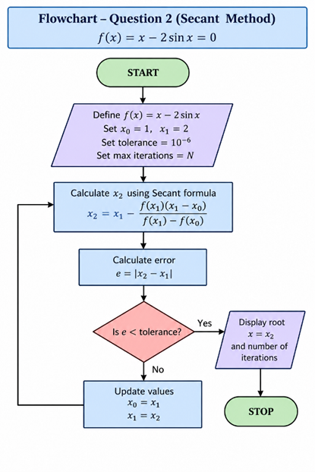
Secant pseudo code and flowchart
Pseudo code
flowchart
START
↓
Define f(x) = x - 2sin(x)
↓
Set x₀ = 1, x₁ = 2
Set tolerance = 10⁻⁶
↓
Calculate x₂ using Secant formula
↓
Calculate error = |x₂ - x₁|
↓
Is error < tolerance?
YES → Display root → STOP
NO → x₀ = x₁
x₁ = x₂
Repeat

Slide 11
The “for” loop
f = @(x) x - 2*sin(x);
x0 = 1;
x1 = 2;
tol = 1e-6;
maxIter = 100;
for i = 1:maxIter
x2 = x1 - f(x1)*(x1-x0)/(f(x1)-f(x0));
error = abs(x2-x1);
if error < tol
break
end
x0 = x1;
x1 = x2;
end
fprintf('Root = %.8f\n',x2);

Slide 12
The “while” loop
f = @(x) x - 2*sin(x);
x0 = 1;
x1 = 2;
tol = 1e-6;
error = Inf;
i = 0;
while error >= tol
i = i + 1;
x2 = x1 - f(x1)*(x1-x0)/(f(x1)-f(x0));
error = abs(x2-x1);
x0 = x1;
x1 = x2;
end
fprintf('Root = %.8f\n',x1);

Slide 13
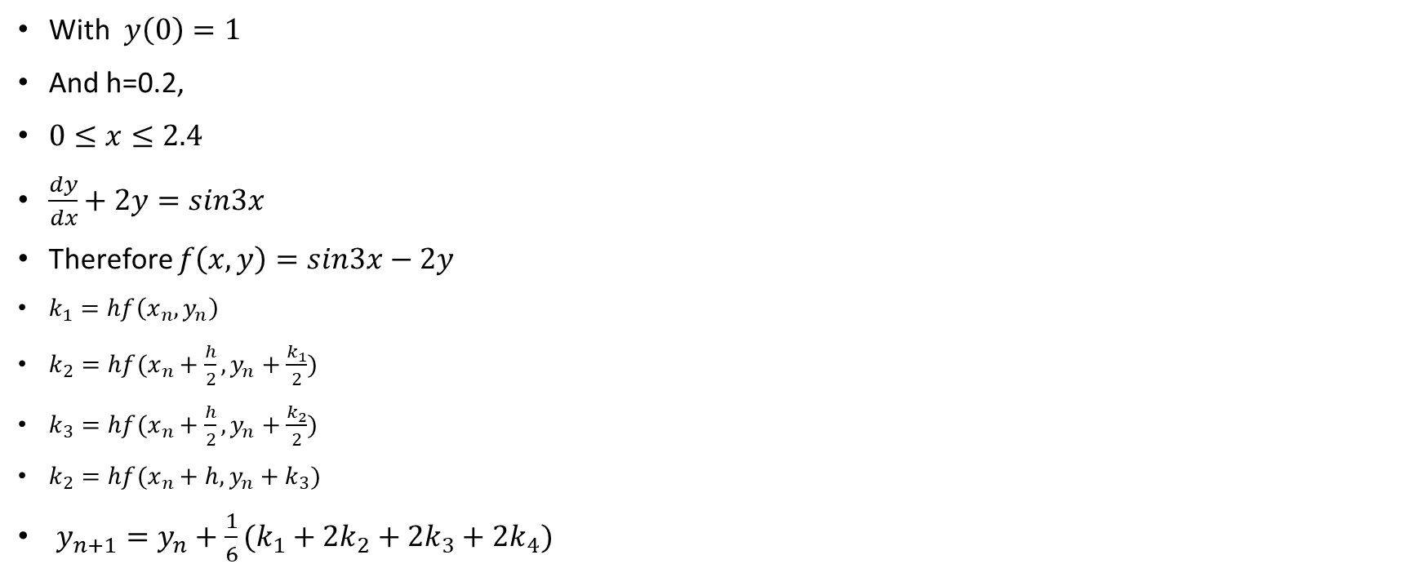
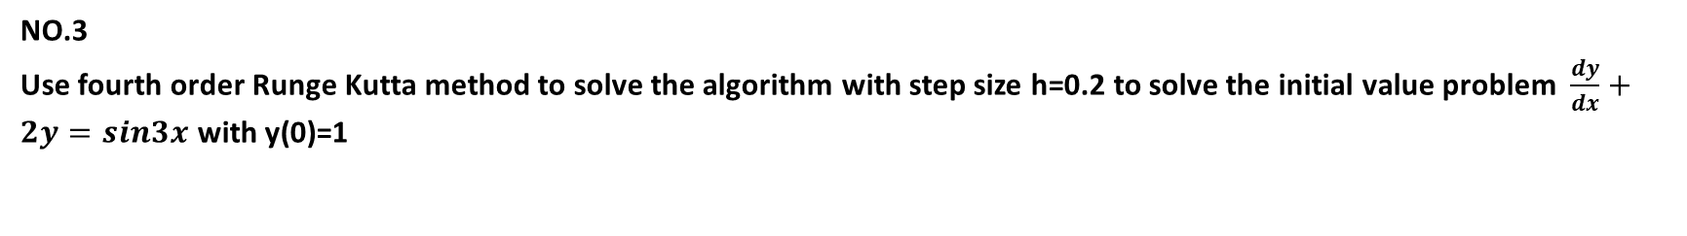
NO.3
Use fourth order Runge Kutta method to solve the algorithm with step size h=0.2 to solve the initial value problem $\frac{dy}{dx}+2y=sin3x$ with y(0)=1
With $y\left(0\right)=1$
And h=0.2,
$0≤x≤2.4$
$\frac{dy}{dx}+2y=sin3x$
Therefore $f\left(x,y\right)=sin3x−2y$
$k_{1}=hf\left(x_{n},y_{n}\right)$
$k_{2}=hf(x_{n}+\frac{h}{2}, y_{n}+\frac{k_{1}}{2})$
$k_{3}=hf(x_{n}+\frac{h}{2}, y_{n}+\frac{k_{2}}{2})$
$k_{2}=hf(x_{n}+h, y_{n}+k_{3})$
$y_{n+1}=y_{n}+\frac{1}{6}(k_{1}+2k_{2}+2k_{3}+2k_{4})$

Slide 14
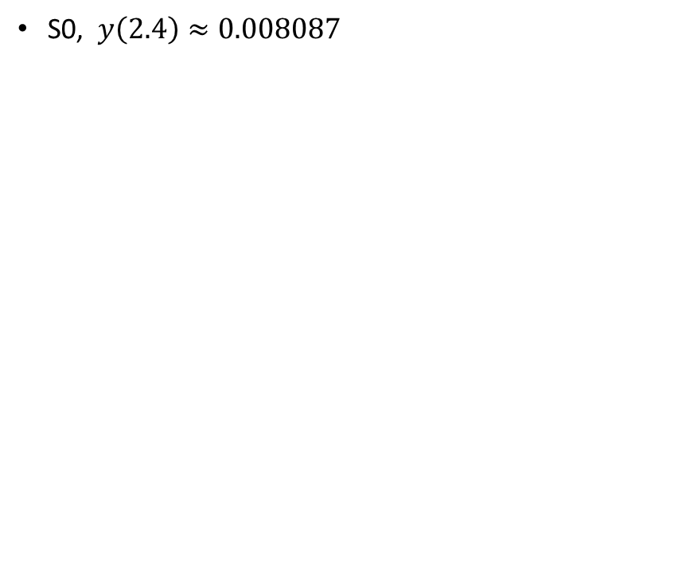
But h=0.2
x | y
0.0 | 1.000000
0.2 | 0.721532
0.4 | 0.612924
0.6 | 0.573054
0.8 | 0.522623
1.0 | 0.416748
1.2 | 0.250514
1.4 | 0.053902
1.6 | -0.123237
1.8 | -0.231648
2.0 | -0.241923
2.2 | -0.156146
2.4 | -0.008087
S0, $y\left(2.4\right)≈0.008087$

Slide 15
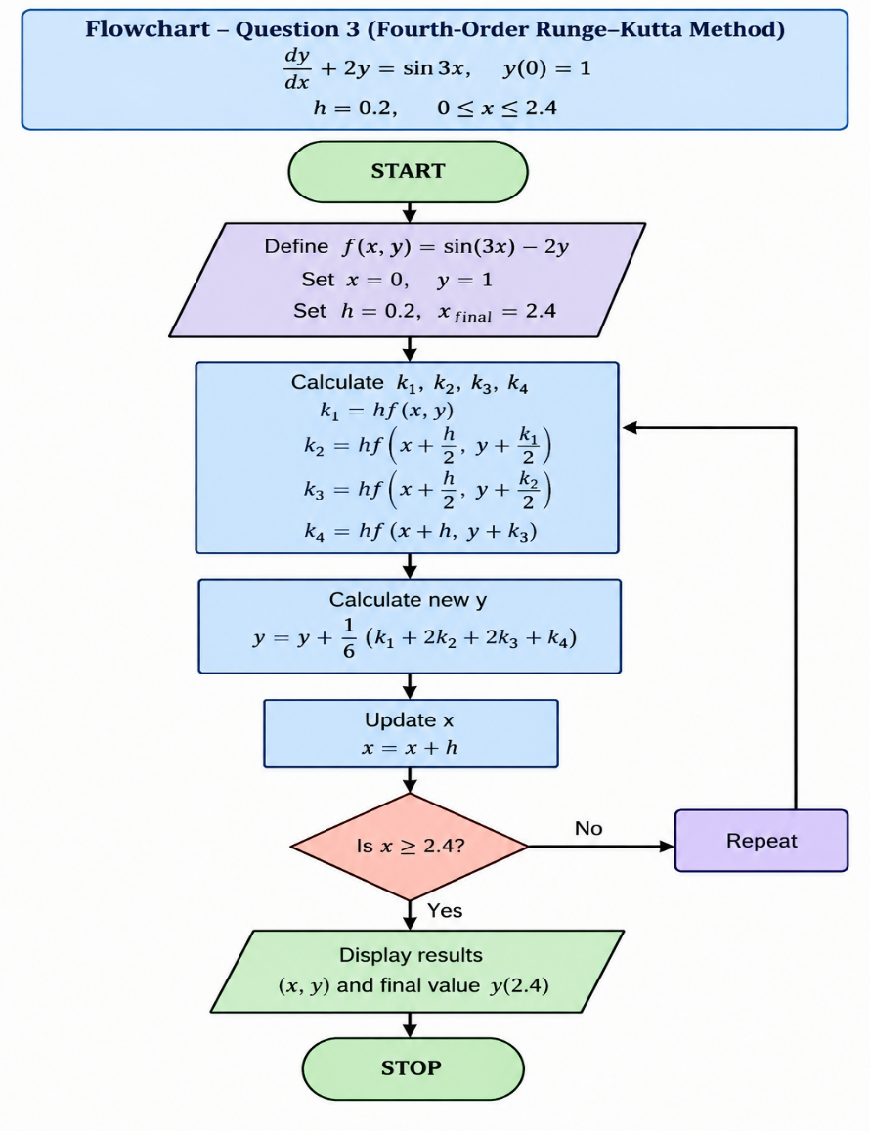
RK4 PSEUDO CODE /FLOWCHART
PSEUDO CODE
FLOWCHART
START
↓
Define f(x,y) = sin(3x) - 2y
↓
Set x = 0, y = 1
Set h = 0.2
Set final x = 2.4
↓
Calculate k1
Calculate k2
Calculate k3
Calculate k4
↓
Calculate new y
↓
Update x
↓
Is x ≥ 2.4?
YES → Display results → STOP
NO → Repeat

Slide 16
The ‘for’ loop
h = 0.2;
x = 0;
y = 1;
n = round((2.4-0)/h);
for i = 1:n
f = @(x,y) sin(3*x) - 2*y;
k1 = h*f(x,y);
k2 = h*f(x+h/2,y+k1/2);
k3 = h*f(x+h/2,y+k2/2);
k4 = h*f(x+h,y+k3);
y = y + (k1+2*k2+2*k3+k4)/6;
x = x + h;
fprintf('x = %.1f, y = %.6f\n',x,y);
end

Slide 17
The ‘while’ loop
h = 0.2;
x = 0;
y = 1;
while x < 2.4
f = @(x,y) sin(3*x) - 2*y;
k1 = h*f(x,y);
k2 = h*f(x+h/2,y+k1/2);
k3 = h*f(x+h/2,y+k2/2);
k4 = h*f(x+h,y+k3);
y = y + (k1+2*k2+2*k3+k4)/6;
x = x + h;
fprintf('x = %.1f, y = %.6f\n',x,y);
end

